Slide 1


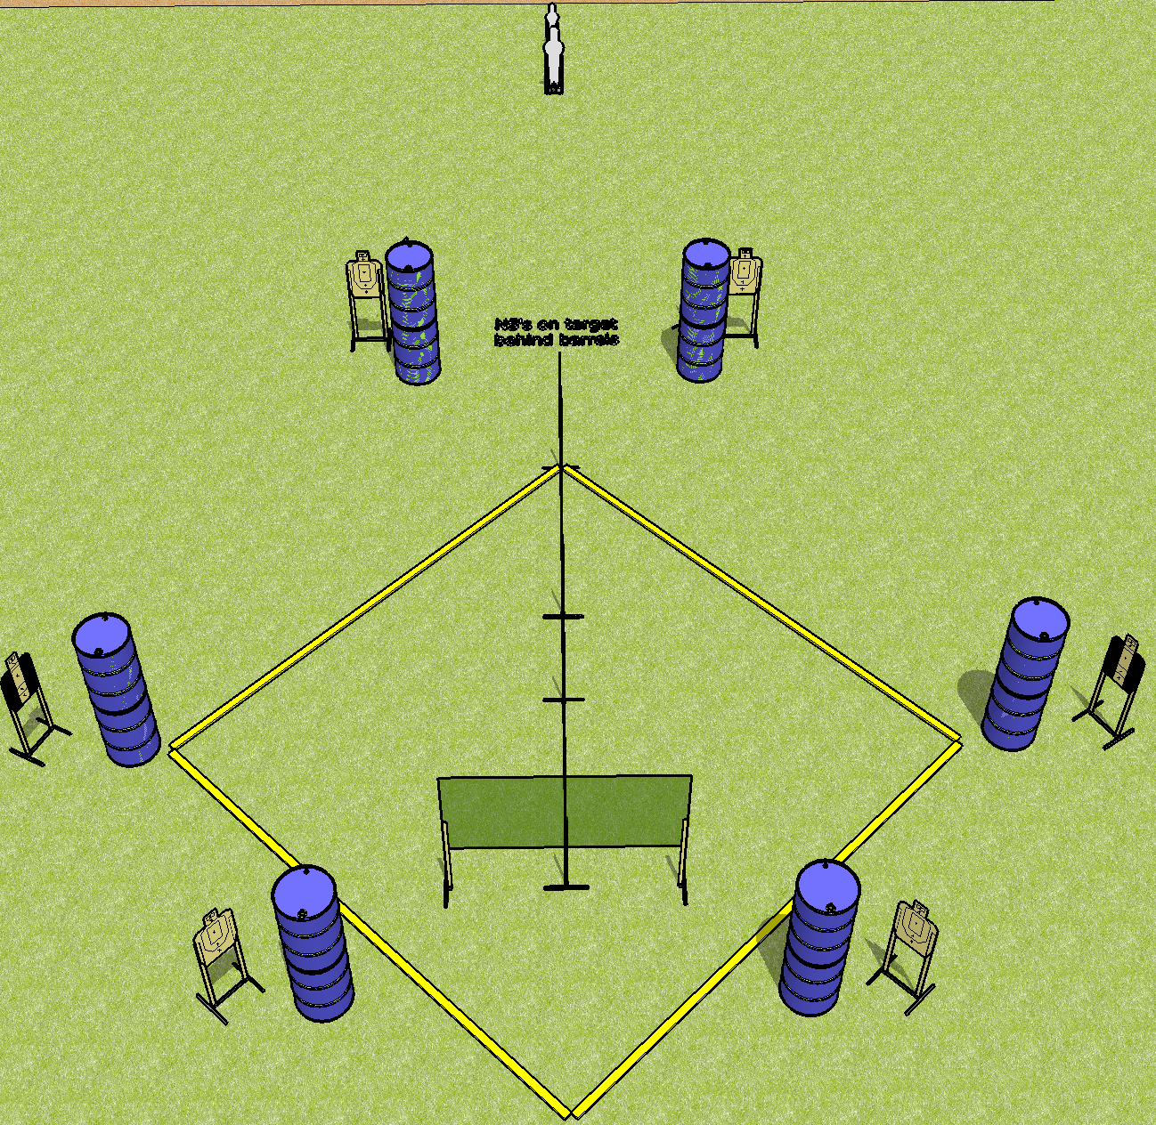
 | Dothan Gun Club – USPSA Match Diamond in the Rough Course Designer : Drew Coleman Bay: B4
Round Count 18 rounds 8 USPSA 1 pepper, 1 mini
Equipment List 6 wall feet 2 tux

Slide 2
Diamond in the Rough
Written Stage Briefing
Scoring: Comstock Rounds: 18 rounds
Targets: 8 USPSA, 2 steel
Handgun start position: hands on marks. Handgun is loaded and holstered.
PCC start position: muzzle touching either mark, stock on belt. Loaded carbine is held with both hands, safety on.
Stage Procedure: on the audible start signal, engage targets as they become available from within the shooting area.

